Slide 1

Department of Computer Science and Engineering, BRAC University
Lecture 7
Combinational Circuits -
MSI Circuits
CSE260 : Digital Logic Design

Slide 2
Design Procedure
The design of combinational circuits starts from the verbal outline of the problem and ends in a logic circuit diagram
2
Department of Computer Science and Engineering
CSE260 - Digital Logic Design

Slide 3
Design Procedure:
The procedure involves the following steps:
1. The problem is stated
2. Input and Output variables are determined
3. Letter symbols are assigned to the input and output variables
6. The logic diagram is drawn
5. The simplified boolean function for each output is obtained
4. Truth table that defines relationship between input and outputs is derived.
Hint: Aren’t these the steps used for solving car-garage alarm system? So we are familiar with combinational circuit design!
3
Department of Computer Science and Engineering
CSE260 - Digital Logic Design

Slide 4
Design Methods
Different combinational circuit design methods:
  Gate-level method (with logic gates)
  Block-level design method
Design methods make use of logic gates and useful functional blocks.
  These are available as Integrated Circuit (IC) chips.
4
Department of Computer Science and Engineering
CSE260 - Digital Logic Design

Slide 5
Design Methods
Why is it better to use IC than classical gate method?
IC consists of gates all packed up together internally, which keeps the gates safe inside as well as makes it economical by reducing external interconnection wires
As number of input increase, making the truth table and k-map gets cumbersome
5
Department of Computer Science and Engineering
CSE260 - Digital Logic Design

Slide 6
Design Methods
Type of IC chips (based on packing density) :
Small-scale integration (SSI) | up to 12 gates
Medium-scale integration (MSI) | 12 - 99 gates
Large-scale integration (LSI) | 100 - 9999 gates
Very large-scale integration (VLSI) | 10,000 - 99,999 gates
Ultra large-scale integration (ULSI) | > 100,000 gates
6
Department of Computer Science and Engineering
CSE260 - Digital Logic Design

Slide 7
Design Methods
Main objectives of circuit design:
  (i) reduce cost
    reduce number of gates (for SSI circuits)
    reduce IC packages (for complex circuits)
  (ii) increase speed
  (iii) design simplicity (reuse blocks where possible)
7
Department of Computer Science and Engineering
CSE260 - Digital Logic Design

Slide 8
Block-Level Design Method
More complex circuits can be built using block-level method.
In general, block-level design method (as opposed to gate-level design) relies on algorithms or formulae of the circuit, which are obtained by decomposing the main problem to sub-problems recursively (until small enough to be directly solved by blocks of circuits).
8
Department of Computer Science and Engineering
CSE260 - Digital Logic Design

Slide 9
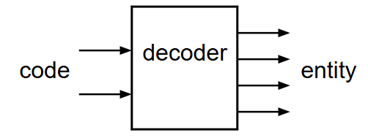
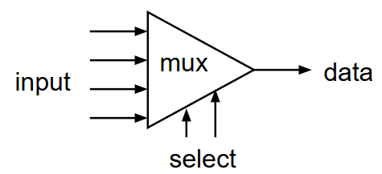
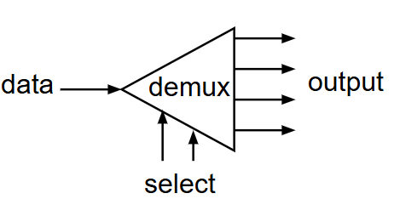
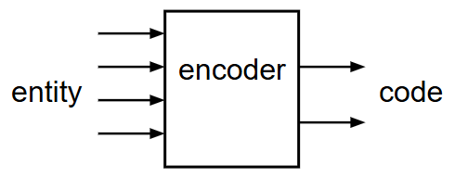
Useful MSI circuits
Four common and useful MSI circuits are:
  Decoder
  Demultiplexer
  Encoder
  Multiplexer
Block-level outlines of MSI circuits:
9
Department of Computer Science and Engineering
CSE260 - Digital Logic Design

Slide 10
Decoders
Convert binary information from n input lines to (max. of) 2^{n} output lines.
Known as n-to-m-line decoder, or simply n:m or n×m decoder (m ≤ 2^{n}).
May be used to generate 2^{n} (or fewer) minterms of n input variables.
10
Department of Computer Science and Engineering
CSE260 - Digital Logic Design

Slide 11
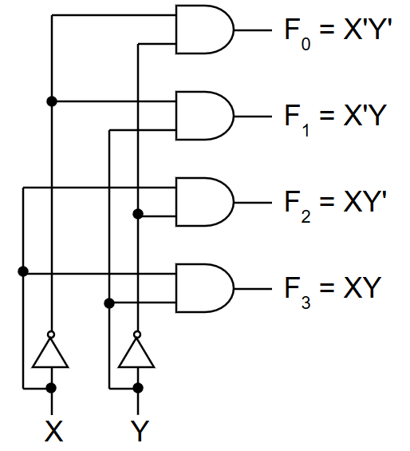
Decoders
From truth table, circuit for 2×4 decoder is:
Note: Each output is a 2-variable minterm (X'Y', X'Y, XY' or XY)
X | Y | F0 | F1 | F2 | F3
0 | 0 | 1 | 0 | 0 | 0
0 | 1 | 0 | 1 | 0 | 0
1 | 0 | 0 | 0 | 1 | 0
1 | 1 | 0 | 0 | 0 | 1
2x4
Dec
F₀ F₁ F₂ F₃
Bulb 0
Bulb 1
Bulb 2
Bulb 3
2-bit code
X
Y
11
Department of Computer Science and Engineering
CSE260 - Digital Logic Design

Slide 12
Decoders
Design a 3×8 decoder by yourself.
12
Department of Computer Science and Engineering
CSE260 - Digital Logic Design

Slide 13
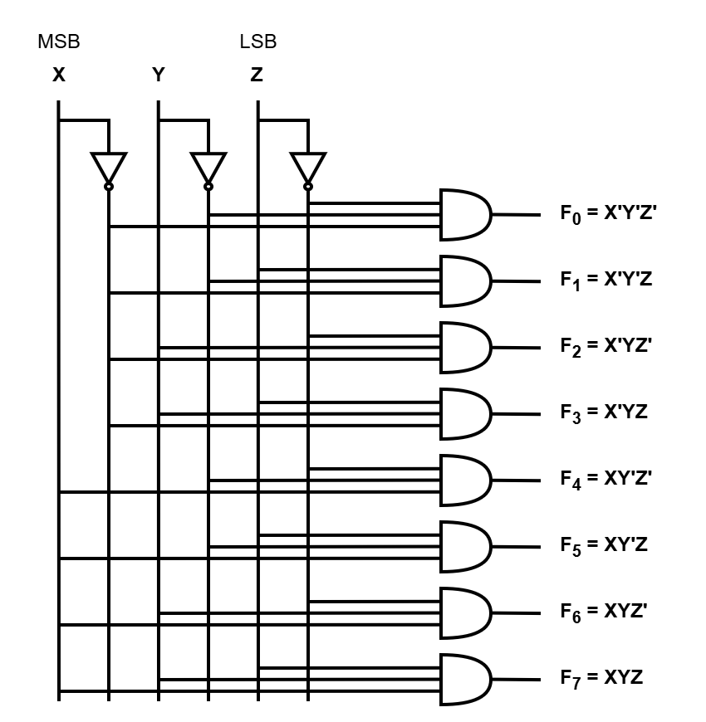
Decoders
Solution:
x | y | z | F₀ | F₁ | F₂ | F₃ | F₄ | F₅ | F₆ | F₇
0 | 0 | 0 | 1 | 0 | 0 | 0 | 0 | 0 | 0 | 0
0 | 0 | 1 | 0 | 1 | 0 | 0 | 0 | 0 | 0 | 0
0 | 1 | 0 | 0 | 0 | 1 | 0 | 0 | 0 | 0 | 0
0 | 1 | 1 | 0 | 0 | 0 | 1 | 0 | 0 | 0 | 0
1 | 0 | 0 | 0 | 0 | 0 | 0 | 1 | 0 | 0 | 0
1 | 0 | 1 | 0 | 0 | 0 | 0 | 0 | 1 | 0 | 0
1 | 1 | 0 | 0 | 0 | 0 | 0 | 0 | 0 | 1 | 0
1 | 1 | 1 | 0 | 0 | 0 | 0 | 0 | 0 | 0 | 1
13
Department of Computer Science and Engineering
CSE260 - Digital Logic Design

Slide 14
Decoders
In general, for an n-bit code, a decoder could select up to 2^{n} lines:
n-bit
code
n to 2^{n}
decoder
up to 2^{n}
output lines
:
:
As n input generates 2^n output, which reminds us of canonical SOP, thus a decoder can be used to generate any function
14
Department of Computer Science and Engineering
CSE260 - Digital Logic Design

Slide 15
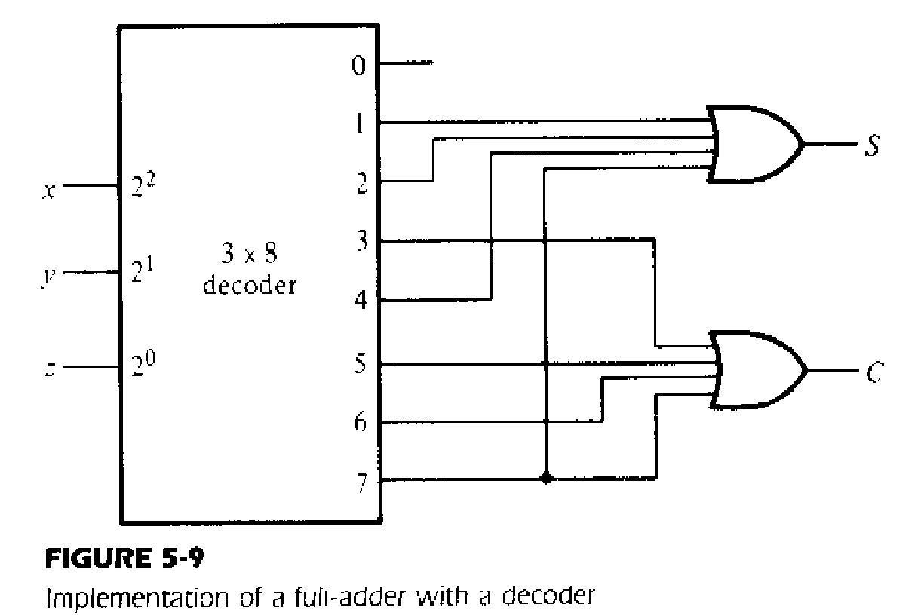
Decoders
Example 1: Full adder circuit with decoder (3 x 8 decoder)
We know,
S(x,y,z) = ∑(1,2,4,7)
C(x,y,z) = ∑(3,5,6,7)
15
Department of Computer Science and Engineering
CSE260 - Digital Logic Design

Slide 16
Demultiplexer
Given an input line and a set of selection lines, the demultiplexer will direct data from input to a selected output line.
An example of a 1-to-4 demultiplexer:
Outputs
S₁ | S₂ | Y₀ | Y₁ | Y₂ | Y₃
0 | 0 | D | 0 | 0 | 0
0 | 1 | 0 | D | 0 | 0
1 | 0 | 0 | 0 | D | 0
1 | 1 | 0 | 0 | 0 | D
Y₀ = D.S₁'.S₀'
Y₁ = D.S₁'.S₀
Data D
demux
Y₂ = D.S₁.S₀'
Y₃ = D.S₁.S₀
S₁ S₀
select
16
Department of Computer Science and Engineering
CSE260 - Digital Logic Design

Slide 17
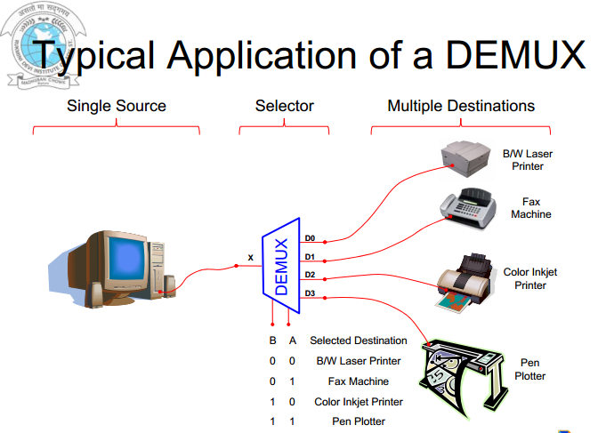
17
Department of Computer Science and Engineering
CSE260 - Digital Logic Design

Slide 18
Demultiplexer
The demultiplexer is actually identical to a decoder with enable. A decoder with an enable input can function as a demultiplexer (or demux)
Decoder + enable= demultiplexer
The selection of a specific output line is controlled by the bit values of ‘n’-selection lines.
Y₀ = D.S₁'.S₀'
Outputs
2x4 Decoder
Y₀
S₁
S₀
Y₁ = D.S₁'.S₀
Y₁
Y₂ = D.S₁.S₀'
Data D
demux
Y₂
E
Y₃ = D.S₁.S₀
Y₃
S₁ S₀
D
select
18
Department of Computer Science and Engineering
CSE260 - Digital Logic Design

Slide 19
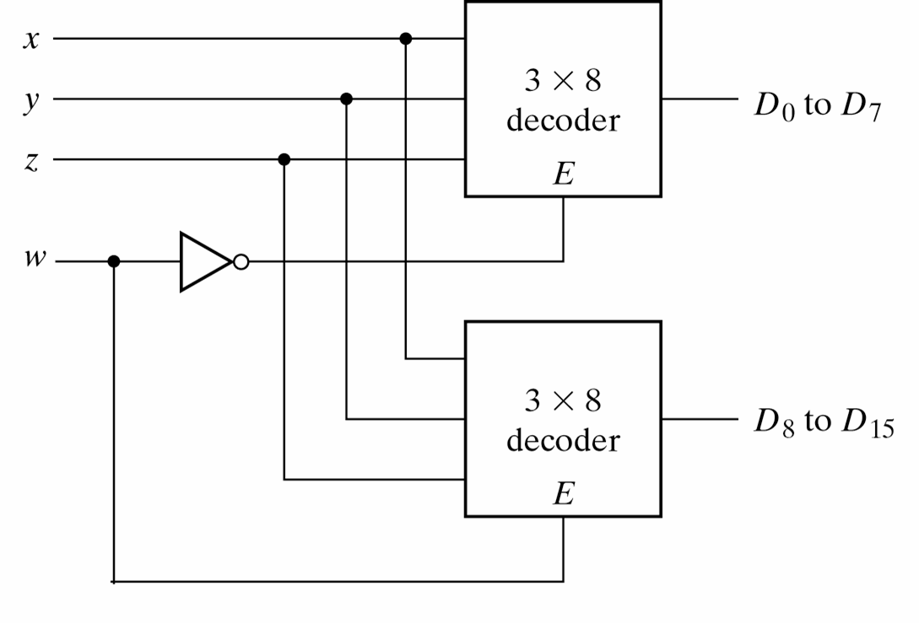
Decoder (More Applications)
4-line-to-16 line Decoder constructed with two 3-line-to-8 line decoders with enables
19
Department of Computer Science and Engineering
CSE260 - Digital Logic Design

Slide 20
Decoder
W | X | Y | Z
0 | 0 | 0 | 0
0 | 0 | 0 | 1
0 | 0 | 1 | 0
0 | 0 | 1 | 1
0 | 1 | 0 | 0
0 | 1 | 0 | 1
0 | 1 | 1 | 0
0 | 1 | 1 | 1
1 | 0 | 0 | 0
1 | 0 | 0 | 1
1 | 0 | 1 | 0
1 | 0 | 1 | 1
1 | 1 | 0 | 0
1 | 1 | 0 | 1
1 | 1 | 1 | 0
1 | 1 | 1 | 1
4-line-to-16 line Decoder constructed with two 3-line-to-8 line decoders with enables
When w=0, the top decoder is enabled and the other is disabled. The bottom decoder outputs are all 0’s , and the top eight outputs generate min-terms 0000 to 0111.
When w=1, the enable conditions are reversed. The bottom decoder outputs generate min-terms 1000 to 1111, while the outputs of the top decoder are all 0’s.
20
Department of Computer Science and Engineering
CSE260 - Digital Logic Design

Slide 21
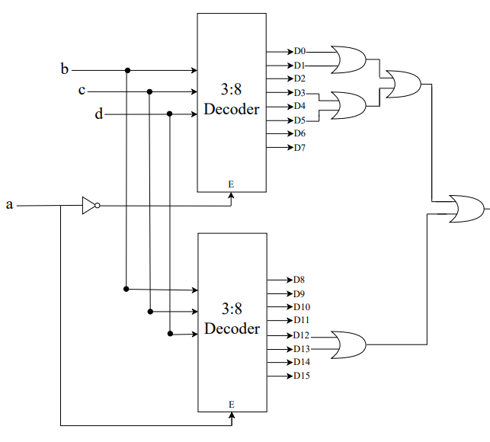
Decoder
F(a,b,c,d)=∑(0,1,3,5,12,13)
Implement the above boolean
function using
a. 3:8 Decoder(s).
b. 2:4 Decoder(s).
21
Department of Computer Science and Engineering
CSE260 - Digital Logic Design

Slide 22
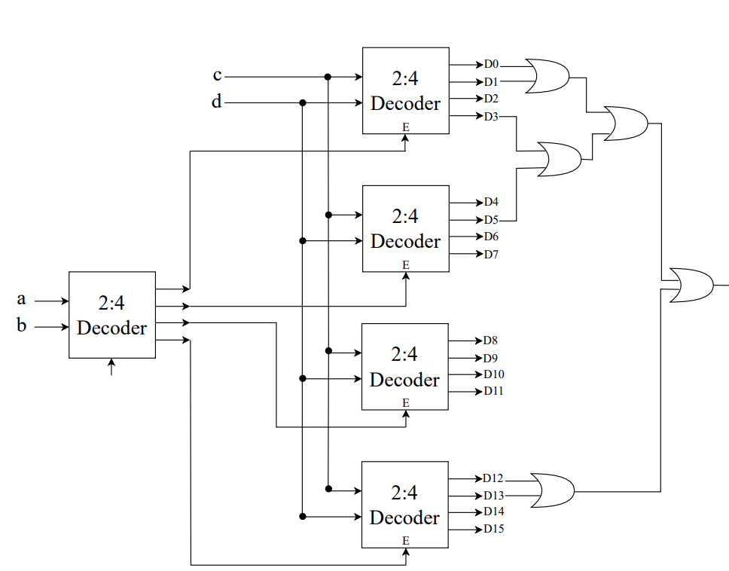
Decoder
F(a,b,c,d)=∑(0,1,3,5,12,13)
Implement the above boolean
function using
a. 3:8 Decoder(s).
b. 2:4 Decoder(s).
22
Department of Computer Science and Engineering
CSE260 - Digital Logic Design

Slide 23
Multiplexer
A multiplexer is a device which has
(i) a number of input lines
(ii) a number of selection lines
(iii) one output line
A Multiplexer steers one of 2^{n} inputs to a single output line, using n selection lines. Also known as a data selector.
2^{n}:1
Multiplexer
inputs
output
:
...
select
23
Department of Computer Science and Engineering
CSE260 - Digital Logic Design

Slide 24
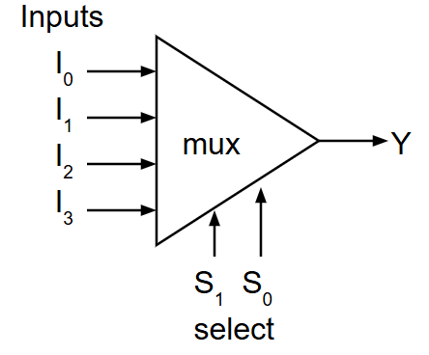
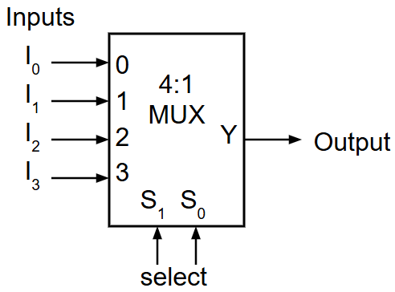
Multiplexer
Truth table for a 4-to-1 multiplexer:
I₀ | I₁ | I₂ | I₃ | S₁ | S₀ | Y
d₀ | d₁ | d₂ | d₃ | 0 | 0 | d₀
d₀ | d₁ | d₂ | d₃ | 0 | 1 | d₁
d₀ | d₁ | d₂ | d₃ | 1 | 0 | d₂
d₀ | d₁ | d₂ | d₃ | 1 | 1 | d₃
S₁ | S₀ | Y
0 | 0 | I₀
0 | 1 | I₁
1 | 0 | I₂
1 | 1 | I₃
24
Department of Computer Science and Engineering
CSE260 - Digital Logic Design

Slide 25
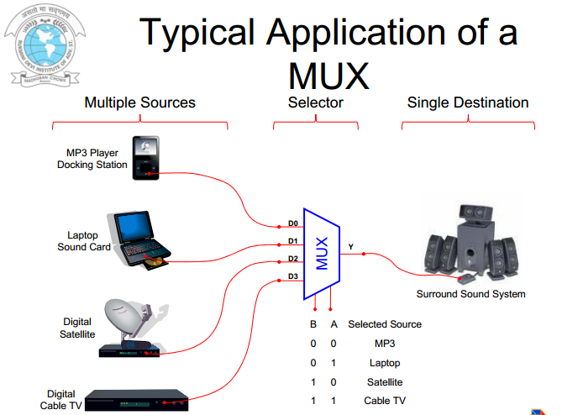
25
Department of Computer Science and Engineering
CSE260 - Digital Logic Design

Slide 26
Multiplexer
Output of multiplexer is
“sum of the (product of data lines and selection lines)”
Often known as Data selector as it selects one of the many inputs and steers the binary information to the output line.
Example: the output of a 4-to-1 multiplexer is:
Y = I₀.(S₁’.S₀') + I₁.(S₁’.S₀) + I₂.(S₁.S₀') + I₃.(S₁.S₀)
26
Department of Computer Science and Engineering
CSE260 - Digital Logic Design

Slide 27
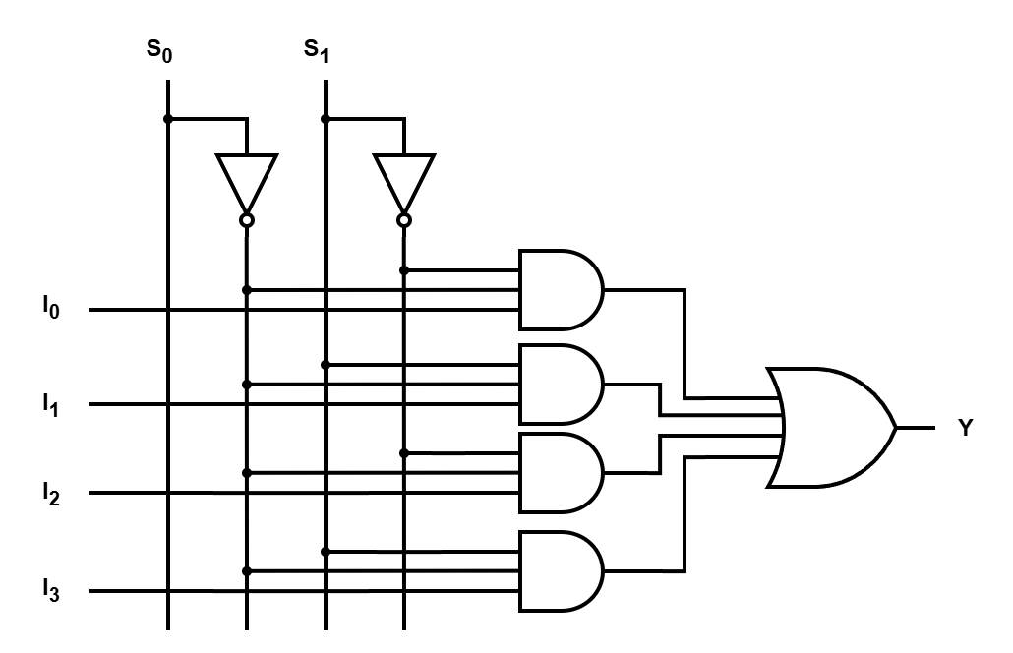
Try it yourself
Draw the internal circuit diagram (logic diagram) of a 4-to-1 multiplexer.
Solution: Y = I₀.(S₁’.S₀') + I₁.(S₁’.S₀) + I₂.(S₁.S₀') + I₃.(S₁.S₀)
S₁ | S₀ | Y
0 | 0 | d₀
0 | 1 | d₁
1 | 0 | d₂
1 | 1 | d₃
(b) Function Table
(a) Logic Diagram
(c) Block Diagram
27
Department of Computer Science and Engineering
CSE260 - Digital Logic Design

Slide 28
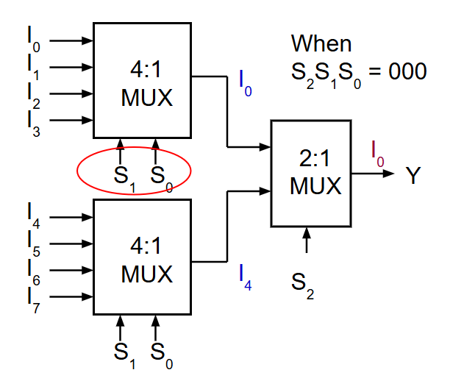
Larger Multiplexers
Larger multiplexers can be constructed from smaller ones.
An 8-to-1 multiplexer can be constructed from smaller multiplexers like this (from two 4x1 and one 2x1):
S₂ | S₁ | S₀ | Y
0 | 0 | 0 | I₀
0 | 0 | 1 | I₁
0 | 1 | 0 | I₂
0 | 1 | 1 | I₃
1 | 0 | 0 | I₄
1 | 0 | 1 | I₅
1 | 1 | 0 | I₆
1 | 1 | 1 | I₇
28
Department of Computer Science and Engineering
CSE260 - Digital Logic Design

Slide 29
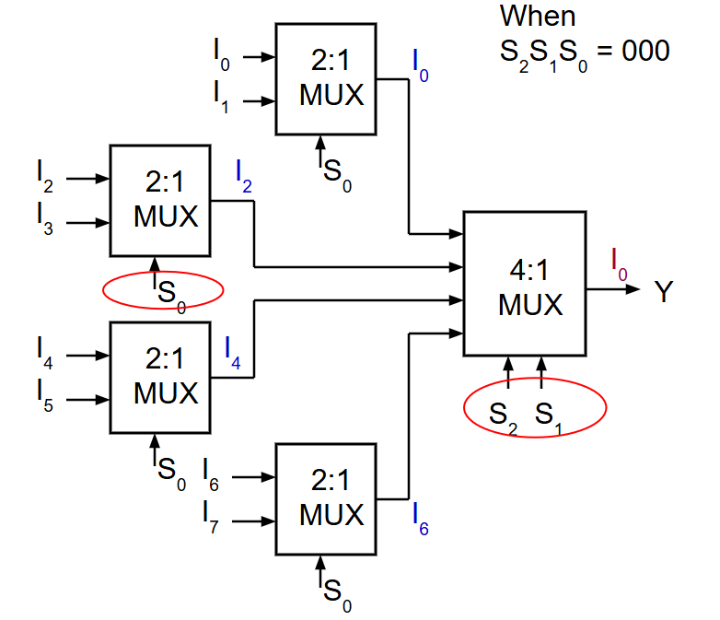
Larger Multiplexers
Another implementation of an 8-to-1 multiplexer using smaller multiplexers (four 2x1 and one 4x1):
S₂ | S₁ | S₀ | Y
0 | 0 | 0 | I₀
0 | 0 | 1 | I₁
0 | 1 | 0 | I₂
0 | 1 | 1 | I₃
1 | 0 | 0 | I₄
1 | 0 | 1 | I₅
1 | 1 | 0 | I₆
1 | 1 | 1 | I₇
Q: Can we use only 2:1 multiplexers?
29
Department of Computer Science and Engineering
CSE260 - Digital Logic Design

Slide 30
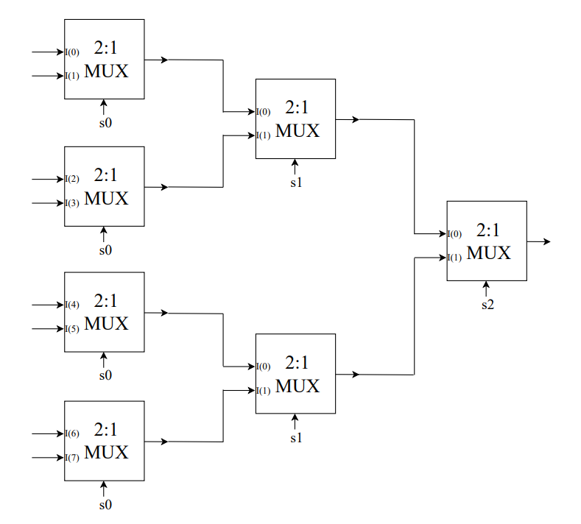
Larger Multiplexers
Q: Can we use only
2:1 multiplexers?
30
Department of Computer Science and Engineering
CSE260 - Digital Logic Design

Slide 31
Try it yourself: Larger Multiplexers
Q: A 16-to-1 multiplexer can be constructed from only 4-to-1 multiplexers:
31
Department of Computer Science and Engineering
CSE260 - Digital Logic Design

Slide 32
Encoder
Encoder is a digital function that produces a reverse operation of a decoder!
It has 2^{n} input lines and n output lines
32
Department of Computer Science and Engineering
CSE260 - Digital Logic Design

Slide 33
Example: Octal-binary encoder
D₀ | D₁ | D₂ | D₃ | D₄ | D₅ | D₆ | D₇ | x | y | z
1 | 0 | 0 | 0 | 0 | 0 | 0 | 0 | 0 | 0 | 0
0 | 1 | 0 | 0 | 0 | 0 | 0 | 0 | 0 | 0 | 1
0 | 0 | 1 | 0 | 0 | 0 | 0 | 0 | 0 | 1 | 0
0 | 0 | 0 | 1 | 0 | 0 | 0 | 0 | 0 | 1 | 1
0 | 0 | 0 | 0 | 1 | 0 | 0 | 0 | 1 | 0 | 0
0 | 0 | 0 | 0 | 0 | 1 | 0 | 0 | 1 | 0 | 1
0 | 0 | 0 | 0 | 0 | 0 | 1 | 0 | 1 | 1 | 0
0 | 0 | 0 | 0 | 0 | 0 | 0 | 1 | 1 | 1 | 1
X = D₄ + D₅ + D₆ + D₇
Y = D₂ + D₃ + D₆ + D₇
Z = D₁ + D₃ + D₅ + D₇
33
Department of Computer Science and Engineering
CSE260 - Digital Logic Design

Slide 34
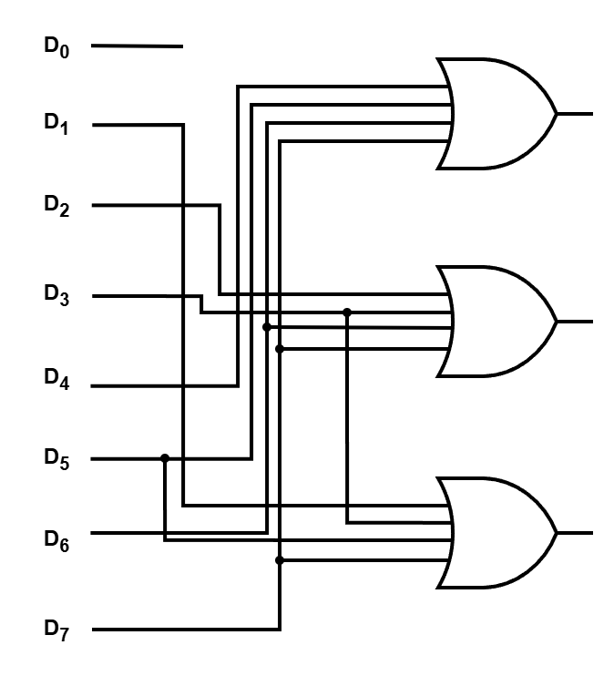
Example: Octal-binary encoder
X = D₄ + D₅ + D₆ + D₇
Y = D₂ + D₃ + D₆ + D₇
Z = D₁ + D₃ + D₅ + D₇
There are 8 input variables so there will be 256 input combination, amongst which in Octal-binary encoder only 8 are useful
Octal to Binary Encoder Logic Diagram
34
Department of Computer Science and Engineering
CSE260 - Digital Logic Design

Slide 35
Priority Encoder
Accepts multiple values and encodes them
  Works when more than one input is active
Consists of:
  Inputs (2^{n})
  Outputs
    when more than one output is active, sets output to correspond to highest input
    V (indicates whether any of the inputs are active). This helps to show the output when all inputs are 0s
  Selectors / Enable
35
Department of Computer Science and Engineering
CSE260 - Digital Logic Design

Slide 36
Example: Priority Encoder
Design a priority encoder, which will allow more than one input to exist and encodes only the highest priority input line. For example, 8x3 encoder in a if user give D2 and D7 together, it will allow data of D7 to pass.
36
Department of Computer Science and Engineering
CSE260 - Digital Logic Design

Slide 37
Example: 4x2 Priority Encoder
Design a priority encoder, which will allow more than one input to exist and encodes only the highest priority input line. For example, 4x2 encoder in a if user give D2 and D3 together, it will allow data of D3 to pass.
37
Department of Computer Science and Engineering
CSE260 - Digital Logic Design

Slide 38
Example: 4x2 Priority Encoder
D₃ | D₂ | D₁ | D₀ | A₁ | A₀ | V
0 | 0 | 0 | 0 | X | X | 0
0 | 0 | 0 | 1 | 0 | 0 | 1
0 | 0 | 1 | 0 | 0 | 1 | 1
0 | 0 | 1 | 1 | 0 | 1 | 1
0 | 1 | 0 | 0 | 1 | 0 | 1
0 | 1 | 0 | 1 | 1 | 0 | 1
0 | 1 | 1 | 0 | 1 | 0 | 1
0 | 1 | 1 | 1 | 1 | 0 | 1
1 | 0 | 0 | 0 | 1 | 1 | 1
1 | 0 | 0 | 1 | 1 | 1 | 1
1 | 0 | 1 | 0 | 1 | 1 | 1
1 | 0 | 1 | 1 | 1 | 1 | 1
1 | 1 | 0 | 0 | 1 | 1 | 1
1 | 1 | 0 | 1 | 1 | 1 | 1
1 | 1 | 1 | 0 | 1 | 1 | 1
1 | 1 | 1 | 1 | 1 | 1 | 1
Designing a 4x2 priority encoder
Note: V is not really an output, just shows whether there is an active input or not.
Note: Amongst all 3 input, D₂ is highest so output reflects the binary value of 2
From the truth table
A₁ = ∑(4,5,6,7,8,9,10,11,12,13,14,15) + d(0)
A₀ = ∑(2,3,8,9,10,11,12,13,14,15) + d(0)
38
Department of Computer Science and Engineering
CSE260 - Digital Logic Design

Slide 39
Example: 4x2 Priority Encoder
A₁ = ∑(4,5,6,7,8,9,10,11,12,13,14,15) + d(0)
A₀ = ∑(2,3,8,9,10,11,12,13,14,15) + d(0)
D₁D₀
D₁
D₁
D₁D₀
D₃D₂
00 01 11 10
00 01 11 10
D₃D₂
00
01
11
10
X
1 | 1 | 1 | 1
1 | 1 | 1 | 1
1 | 1 | 1 | 1
X |  | 1 | 1
1 | 1 | 1 | 1
1 | 1 | 1 | 1
00
01
11
10
D₂
D₂
D₃
D₃
D₀
D₀
A₁ = D₂ + D₃
A₀ = D₃ + D₁D₂’
39
Department of Computer Science and Engineering
CSE260 - Digital Logic Design

Slide 40
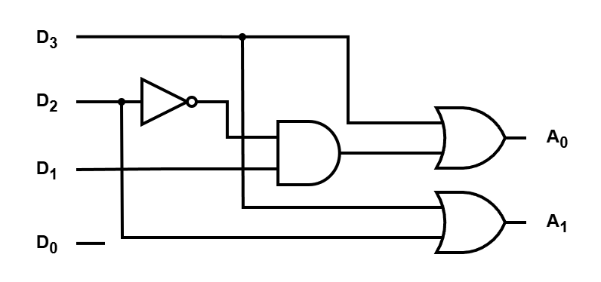
Example: 4x2 Priority Encoder
A₁ = D₂ + D₃ A₀ = D₃ + D₁D₂’
40
Department of Computer Science and Engineering
CSE260 - Digital Logic Design

Slide 41
Boolean Function Implementation using MSI Circuits
41
Department of Computer Science and Engineering
CSE260 - Digital Logic Design

Slide 42
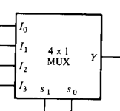
Try it yourself
AND
GND
Using 4:1 MUX design
AND gate
OR gate
NOT gate
+5v
A B
OR
NOT
GND
+5v
+5v
X
X
GND
A B
A
42
Department of Computer Science and Engineering
CSE260 - Digital Logic Design

Slide 43
Try it yourself
a)Build the following function using 8x1 Mux.
F(A,B,C)=∑(0,4,5)
b)Design same thing with 3x8 decoder
c) Try designing it with single 4x1 Mux
43
Department of Computer Science and Engineering
CSE260 - Digital Logic Design

Slide 44
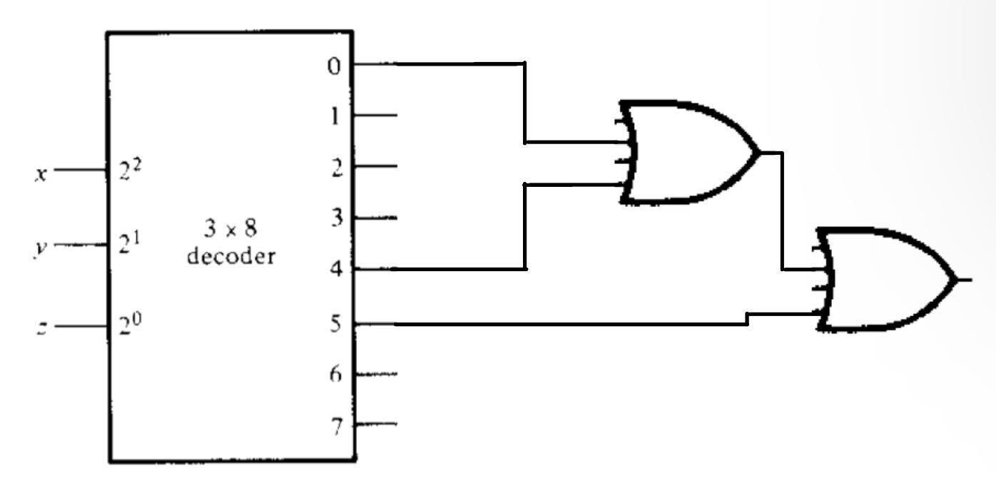
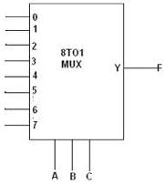
Solution
F=∑(0,4,5)
a)
b)
5V
44
Department of Computer Science and Engineering
CSE260 - Digital Logic Design

Slide 45
Rules: for using smaller mux to build larger equation
If the two minterms in a column are not circled, apply 0 to the corresponding multiplexer input.
If the two minterms are circled, apply 1 to the corresponding multiplexer input.
If the bottom minterm is circled and the top is not circled, apply A to the corresponding multiplexer input.
If the top minterm is circled and the bottom is not circled, apply A' to the corresponding multiplexer input.
45
Department of Computer Science and Engineering
CSE260 - Digital Logic Design

Slide 46
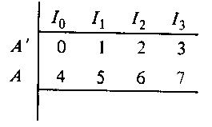
Solution
Answer: Part ( c )
1
A
0
0
1 A 0 0
B C
46
Department of Computer Science and Engineering
CSE260 - Digital Logic Design

Slide 47
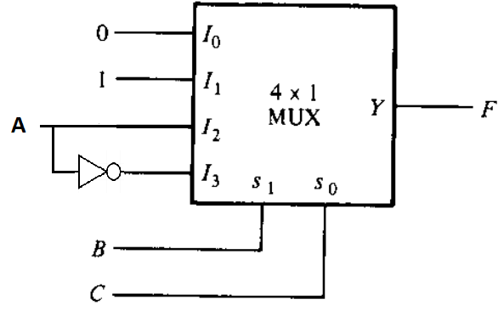
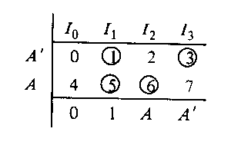
Build the following function using 4x1 MUX
F(A,B,C) = ∑ ( 1, 3, 5, 6)
47
Department of Computer Science and Engineering
CSE260 - Digital Logic Design

Slide 48
Try it yourself
Implement the below function using a 8x1 Mux.
Implement the below function using a 4x16 decoder and OR gates
F(A,B,C,D) = ∑ ( 0,1,3,4,8,9,15)
48
Department of Computer Science and Engineering
CSE260 - Digital Logic Design

Slide 49
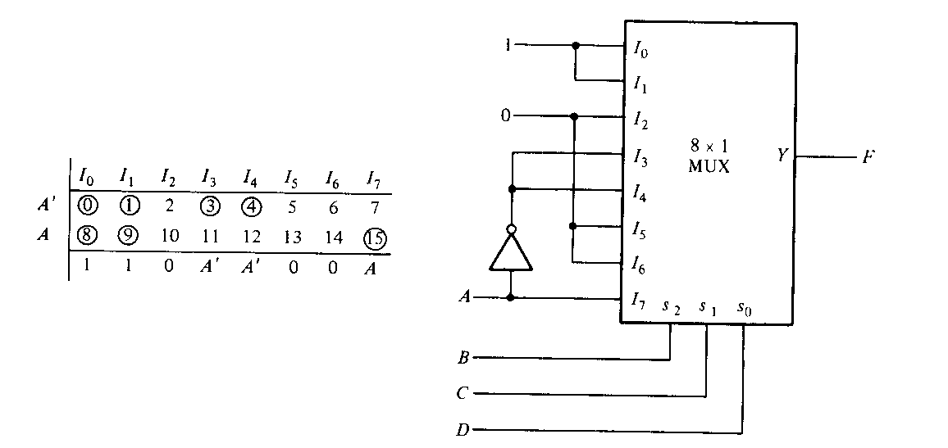
Solution
a.
49
Department of Computer Science and Engineering
CSE260 - Digital Logic Design

Slide 50
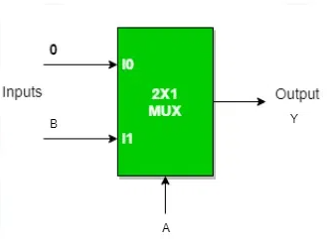
Home-task: Try it yourself
Using 2:1 MUX design
AND gate
OR gate
NOT gate
Solution: Try YOUTUBE
50
Department of Computer Science and Engineering
CSE260 - Digital Logic Design

Slide 51
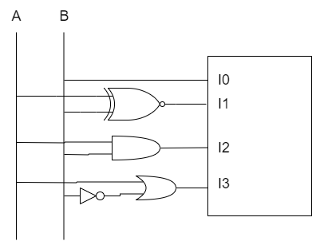
4 variables with 4x1 Mux
A | B | C | D | min
0 | 0 | 0 | 0 | 0
0 | 0 | 0 | 1 | 1
0 | 0 | 1 | 0 | 2
0 | 0 | 1 | 1 | 3
0 | 1 | 0 | 0 | 4
0 | 1 | 0 | 1 | 5
0 | 1 | 1 | 0 | 6
0 | 1 | 1 | 1 | 7
1 | 0 | 0 | 0 | 8
1 | 0 | 0 | 1 | 9
1 | 0 | 1 | 0 | 10
1 | 0 | 1 | 1 | 11
1 | 1 | 0 | 0 | 12
1 | 1 | 0 | 1 | 13
1 | 1 | 1 | 0 | 14
1 | 1 | 1 | 1 | 15
F(A,B,C,D) = ∑ ( 1,3,4,11,12,13,14,15)
 | I₀ | I₁ | I₂ | I₃
A’B’ | 0 | 1 | 2 | 3
A’B | 4 | 5 | 6 | 7
AB’ | 8 | 9 | 10 | 11
AB | 12 | 13 | 14 | 15
 | B | A⊙B | AB | A+B’
https://www.youtube.com/watch?v=c8lhlAX2JMk
51
Department of Computer Science and Engineering
CSE260 - Digital Logic Design

Slide 52
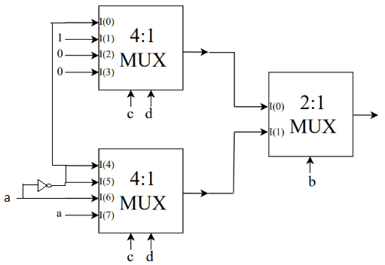
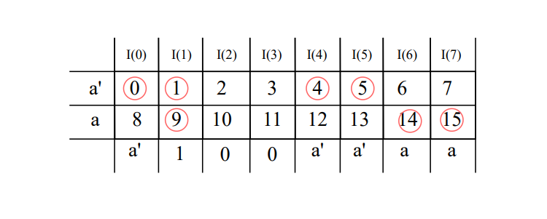
Try it yourself
Implement the boolean function using two 4:1 MUX(s) and one 2:1 MUX.
F(A,B,C,D) = ∑ (0,1,4,5,9,14,15)
52
Department of Computer Science and Engineering
CSE260 - Digital Logic Design

Slide 53
Combining MSI to build Combinational Design Circuit
53
Department of Computer Science and Engineering
CSE260 - Digital Logic Design

Slide 54
Exercise time!
Design a BCD to Excess 3 code converter using ‘4x16’ decoder and ‘16x4’ encoder
54
Department of Computer Science and Engineering
CSE260 - Digital Logic Design

Slide 55
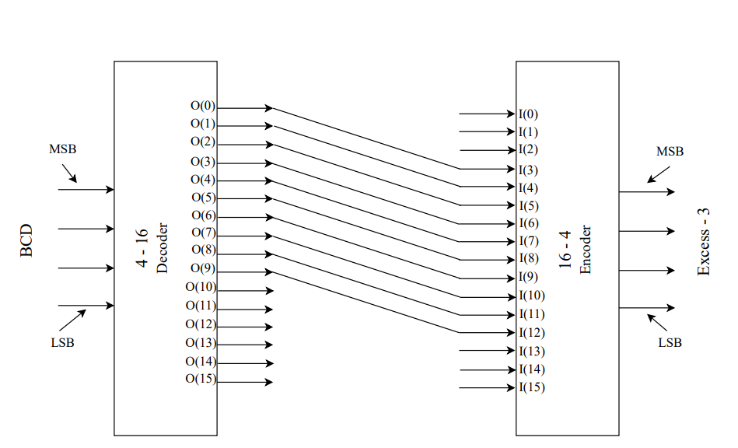
Solution:
55
Department of Computer Science and Engineering
CSE260 - Digital Logic Design

Slide 56
Exercise time!
Design a full adder using ‘3x8’ decoder and ‘4x2’ encoder
56
Department of Computer Science and Engineering
CSE260 - Digital Logic Design

Slide 57
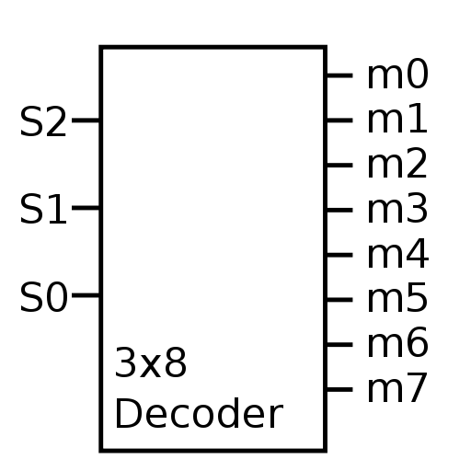
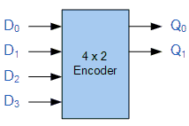
Solution
X | Y | Z | C | S
0 | 0 | 0 | 0 | 0
0 | 0 | 1 | 0 | 1
0 | 1 | 0 | 0 | 1
0 | 1 | 1 | 1 | 0
1 | 0 | 0 | 0 | 1
1 | 0 | 1 | 1 | 0
1 | 1 | 0 | 1 | 0
1 | 1 | 1 | 1 | 1
57
Department of Computer Science and Engineering
CSE260 - Digital Logic Design

Slide 58
Exercise time!
Design a 2-bit parallel adder where you have to use appropriate encoders and decoders to build the internal circuit.
58
Department of Computer Science and Engineering
CSE260 - Digital Logic Design

Slide 59
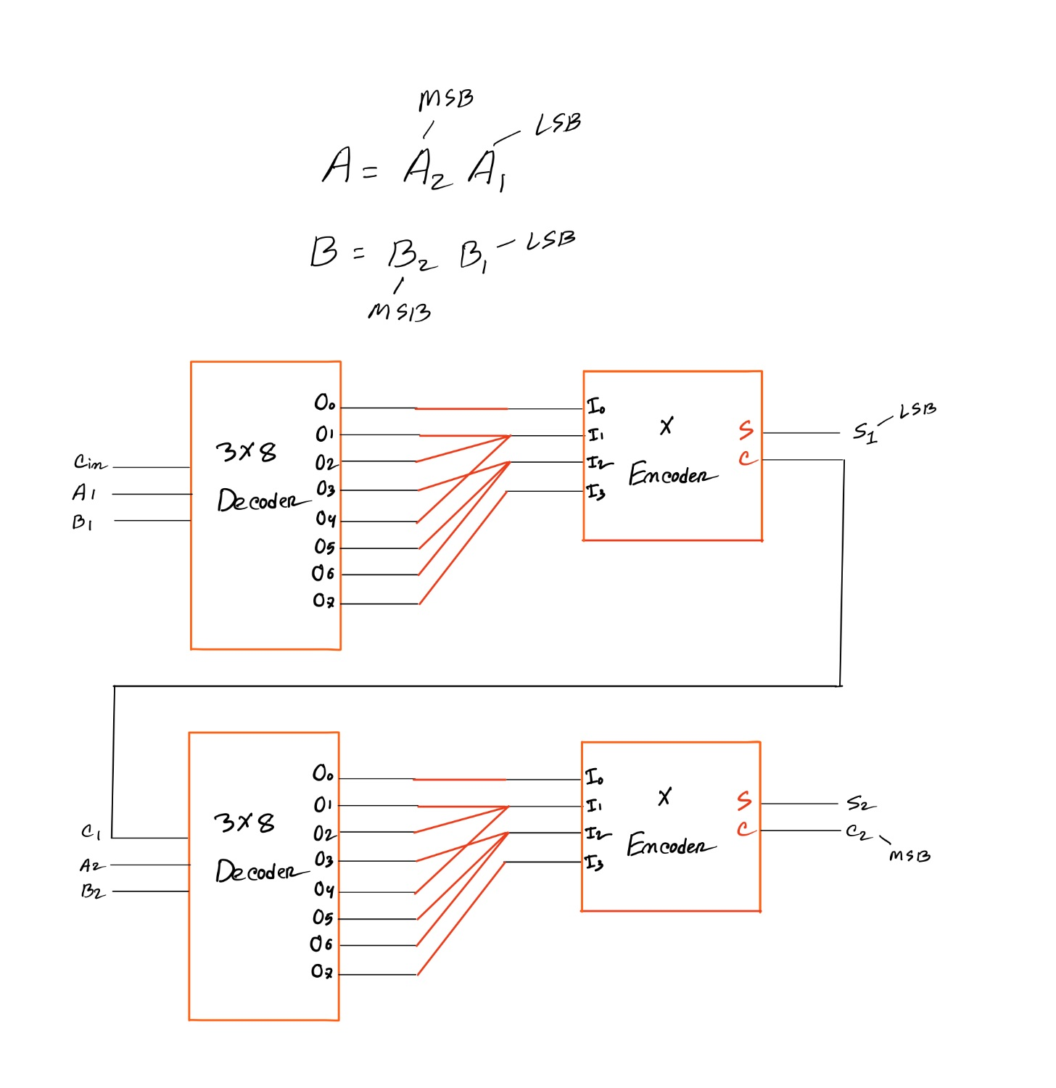
Solution
4
2
4
2
59
Department of Computer Science and Engineering
CSE260 - Digital Logic Design

Slide 60
Exercise time!
Design a 7 person voting system using encoder(s) and decoder(s) and parallel adder(s). You can not use full adders. Meaning, for the inputs, you MUST use encoder(s) and decoder(s) as required.
60
Department of Computer Science and Engineering
CSE260 - Digital Logic Design

Slide 61
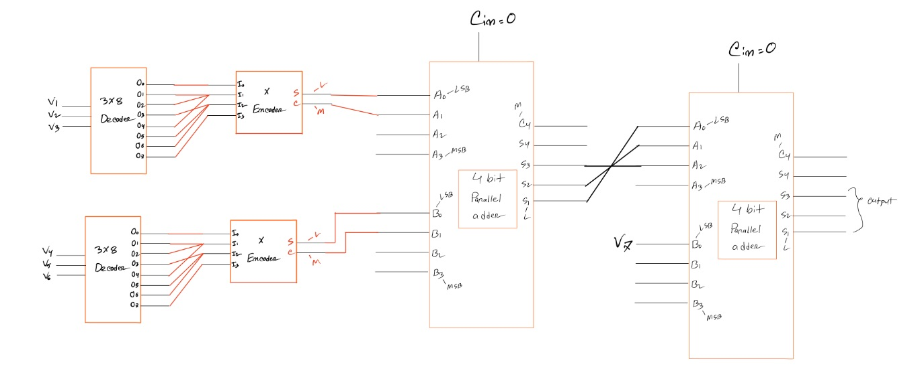
Solution
4
2
4
2
61
Department of Computer Science and Engineering
CSE260 - Digital Logic Design

Slide 62
Try Yourself!
Design a 19 person voting system using encoder(s) and decoder(s) and parallel adder(s). You can not use full adders. Meaning, for the inputs, you MUST use encoder(s) and decoder(s) as required. Make sure your circuit is optimized.
62
Department of Computer Science and Engineering
CSE260 - Digital Logic Design

